Slide 1
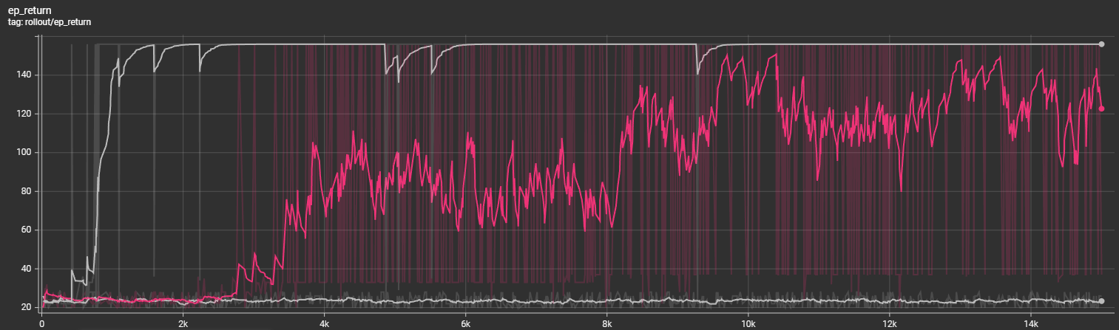
Train without Augmentation on different configurations
1
2
3
Two configurations: (30, 10), (28, 10)
Seven configurations: (30, 10), (28, 10), (32, 10), (26, 10), (34, 10), (30, 14), (28, 14)
Nine configurations: (30, 10), (28, 10), (32, 10), (26, 10), (34, 10), (30, 14), (28, 14), (32, 14), (26, 14)

Slide 2
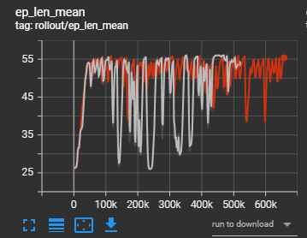
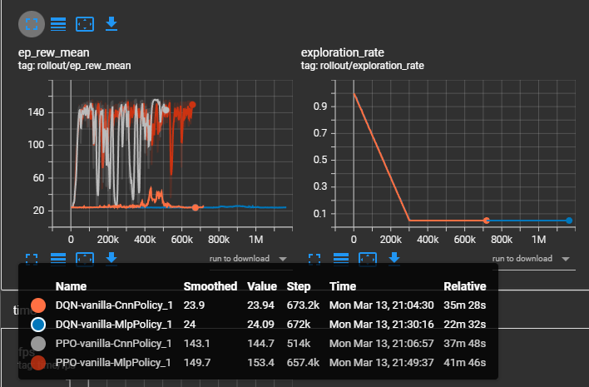
PPO vs DQN
However, what is interesting is that a MPL policy (red) seems to learn smoother than a CNN policy.
But I guess the CNN should lead to better generalization due to kernel shift

Slide 3
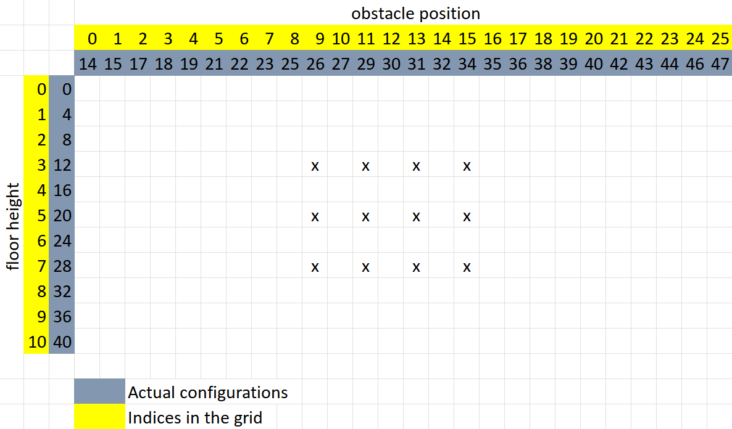
Narrow grid

Slide 4
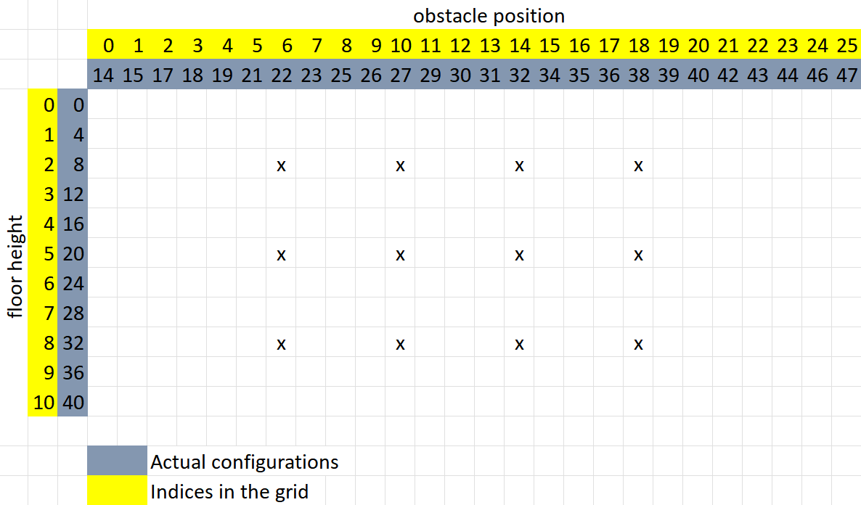
wide grid

Slide 5
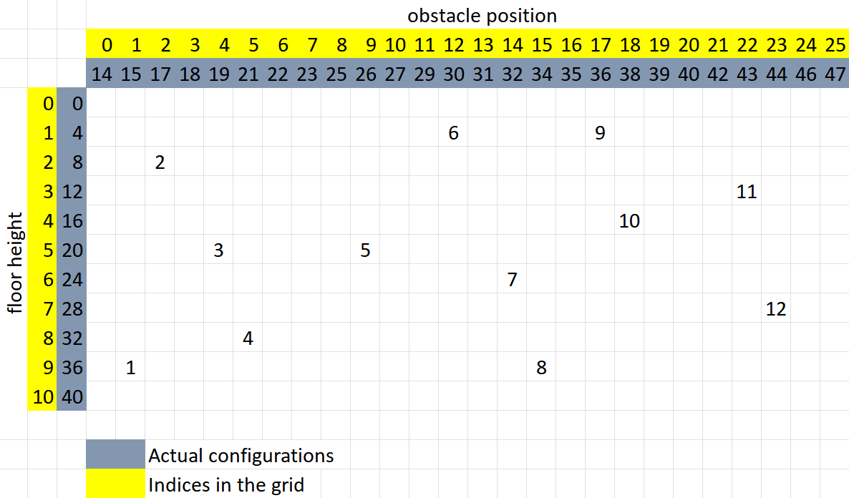
random grid

Slide 6
The following tests were done without any augmentation

Slide 7
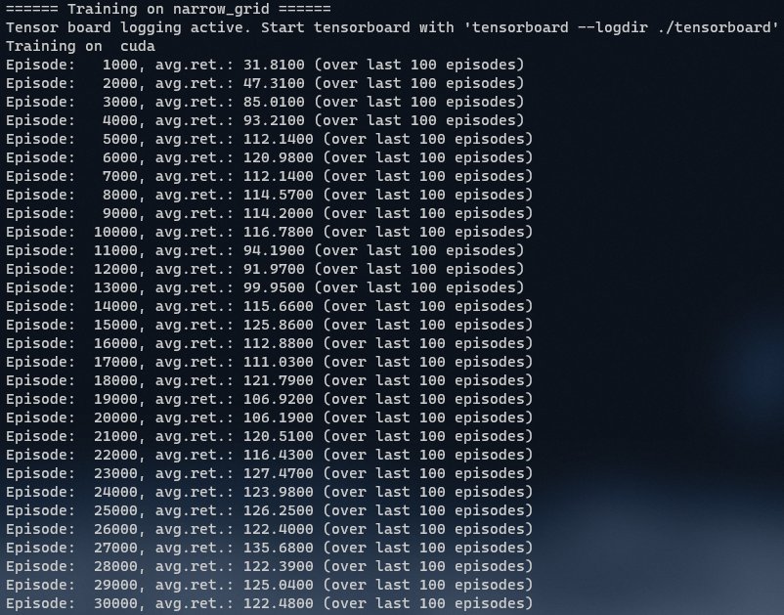
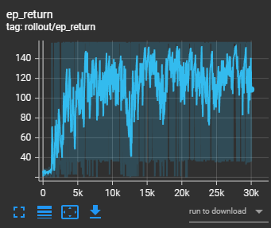
Smoothing 0.8

Slide 8
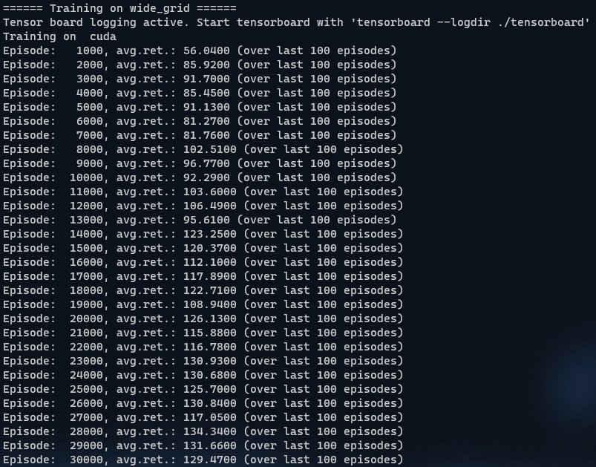
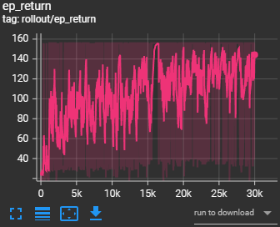
Smoothing 0.8

Slide 9
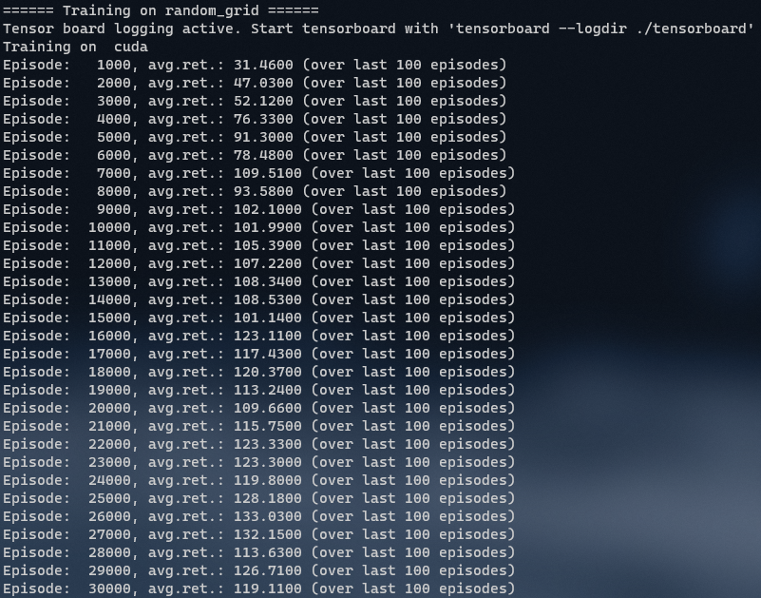
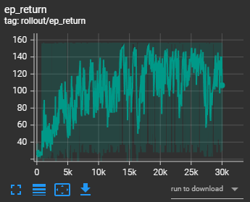
Smoothing 0.8

Slide 10
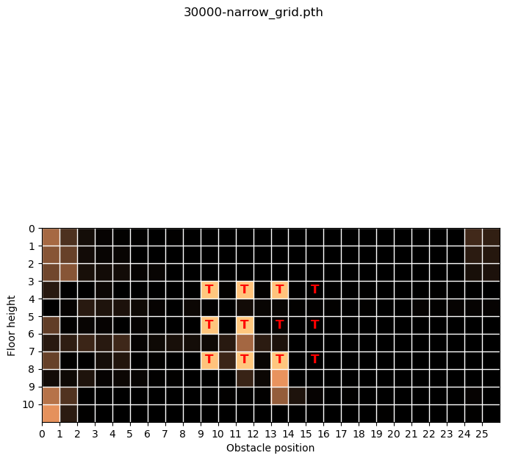

Slide 11
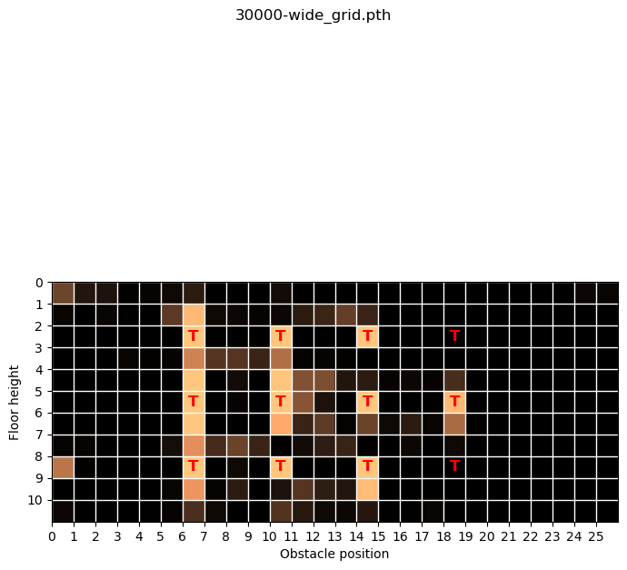

Slide 12
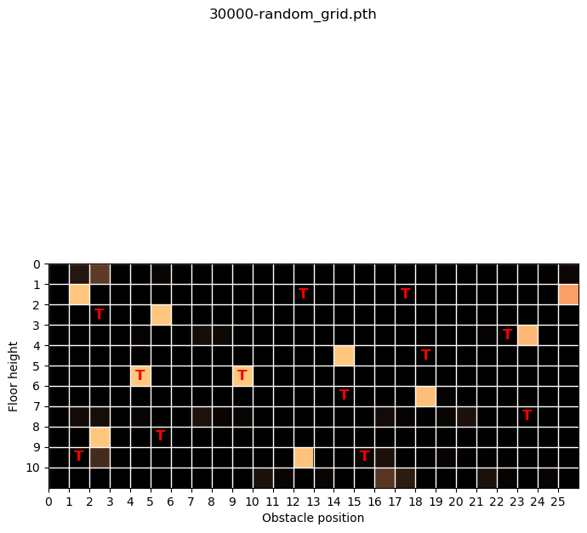

Slide 13
The following tests were done with random augmentation which changes at every step()

Slide 14
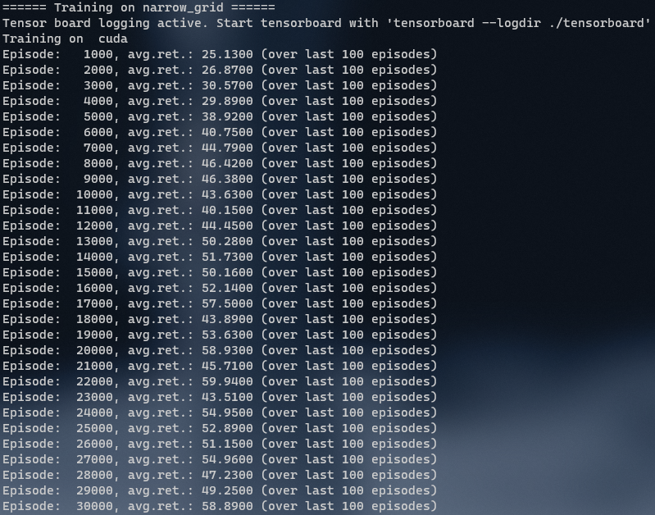
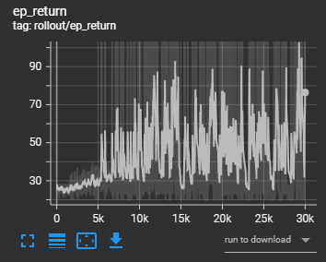
Smoothing 0.8

Slide 15
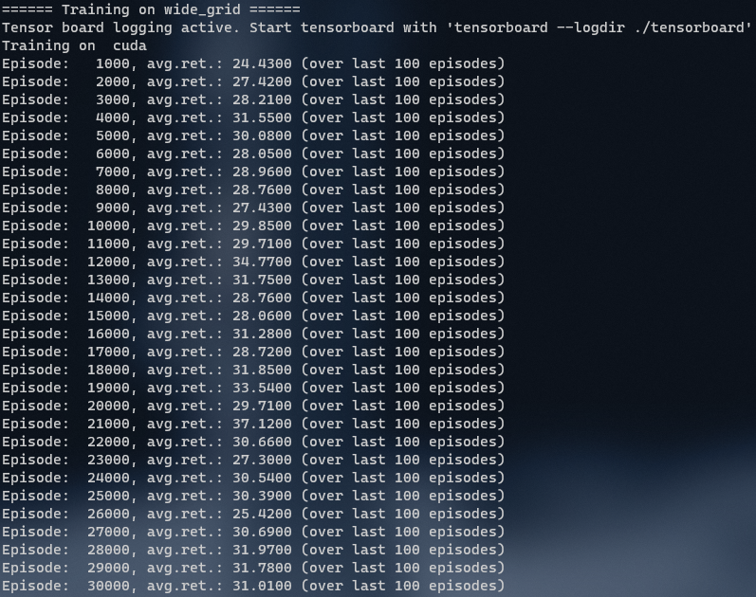
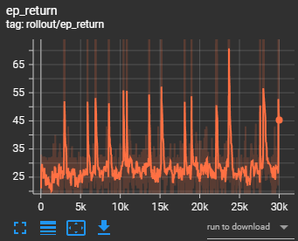
Smoothing 0.8

Slide 16
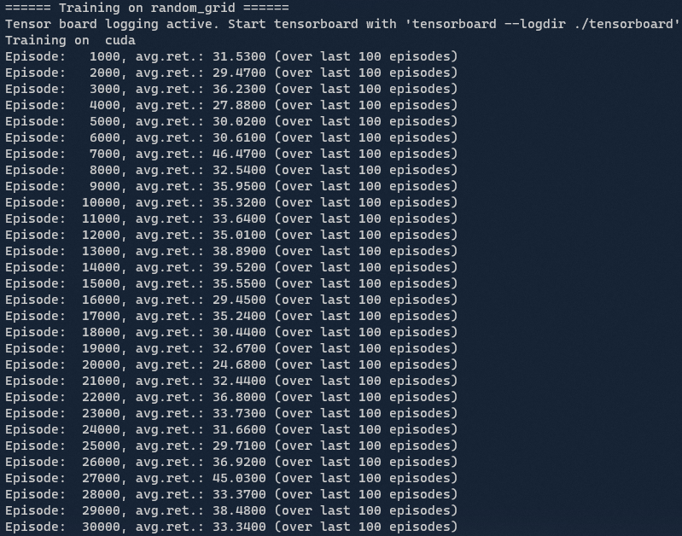
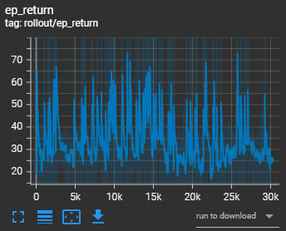
Smoothing 0.8

Slide 17
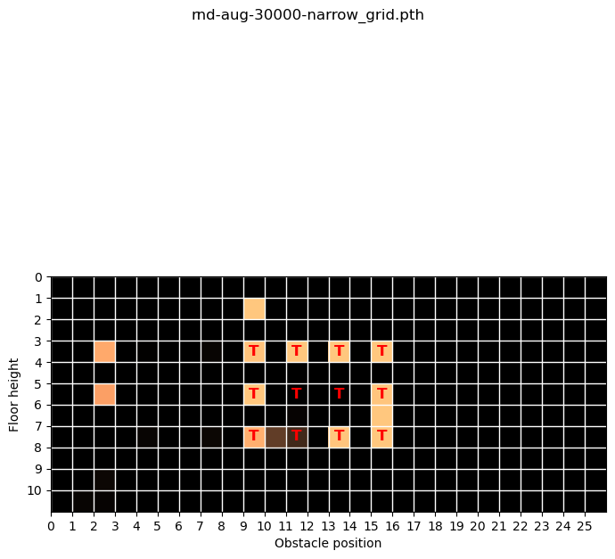

Slide 18
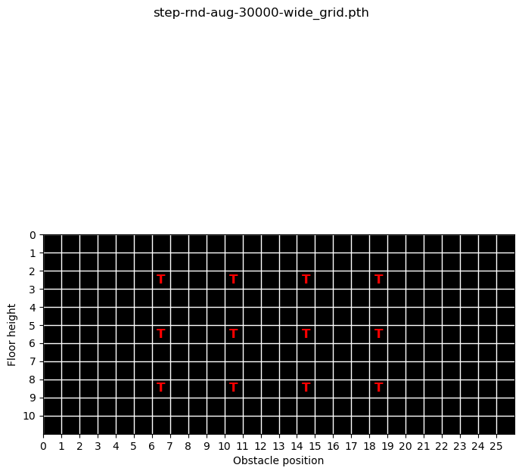

Slide 19
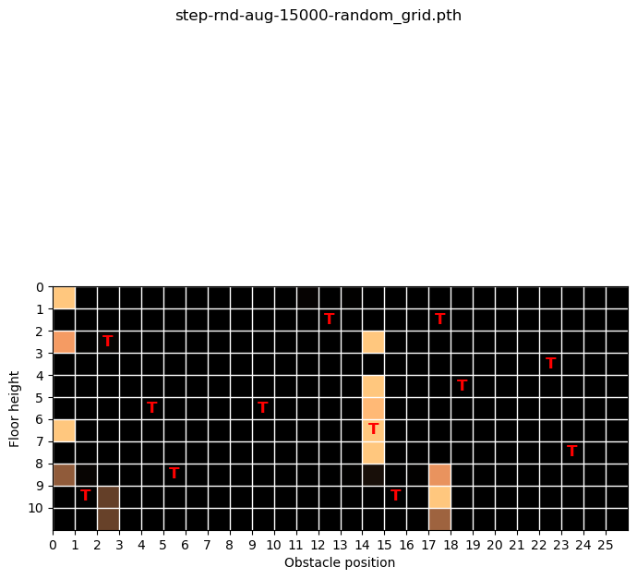

Slide 20
The following tests were done with random augmentation which changes every episode

Slide 21
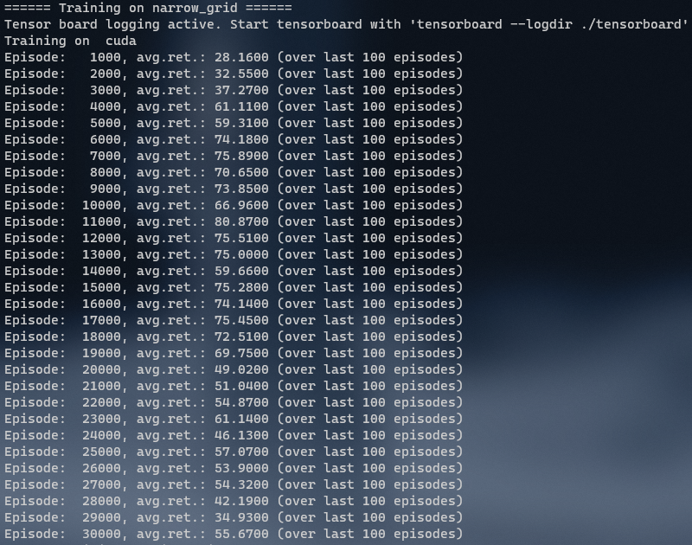
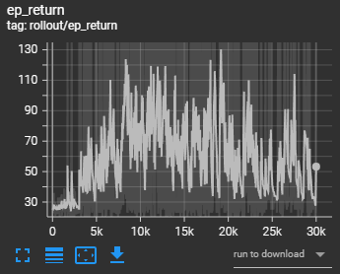
Smoothing 0.8

Slide 22
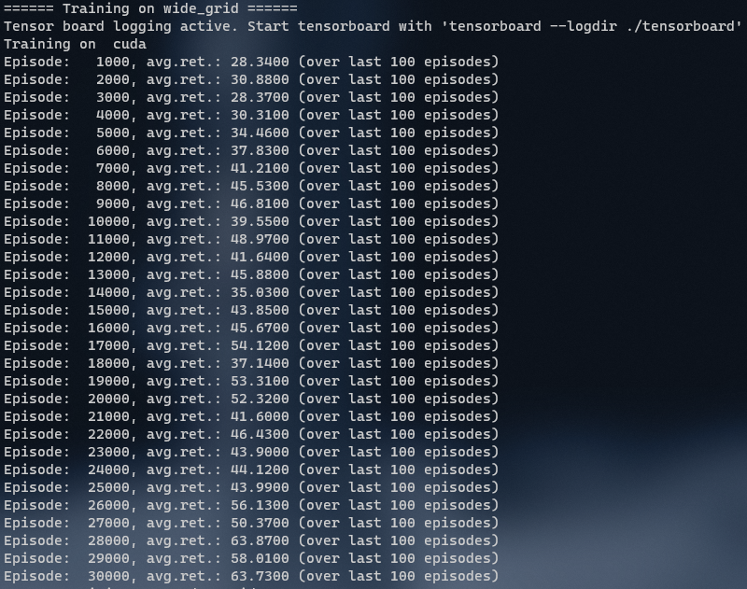
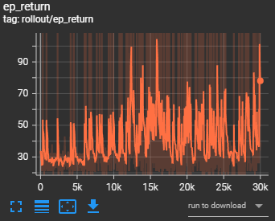
Smoothing 0.8

Slide 23
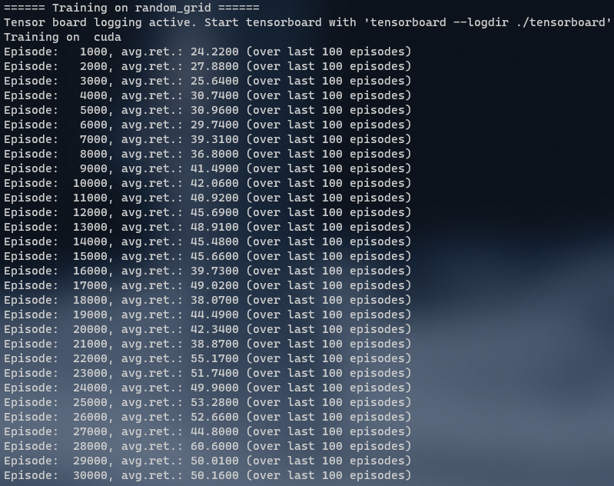
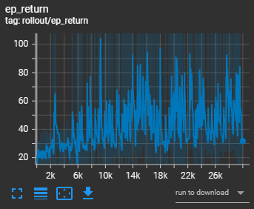
Smoothing 0.8

Slide 24
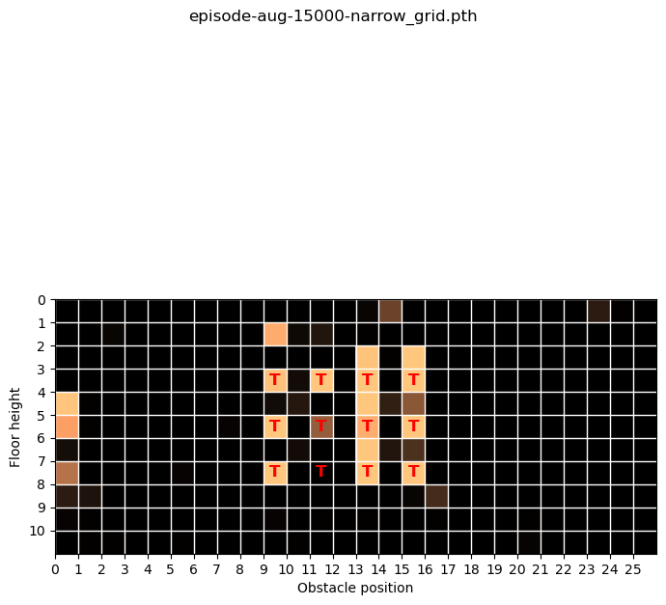

Slide 25
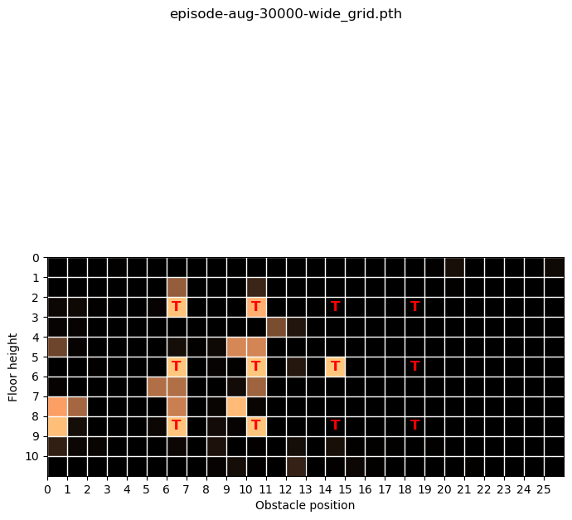

Slide 26
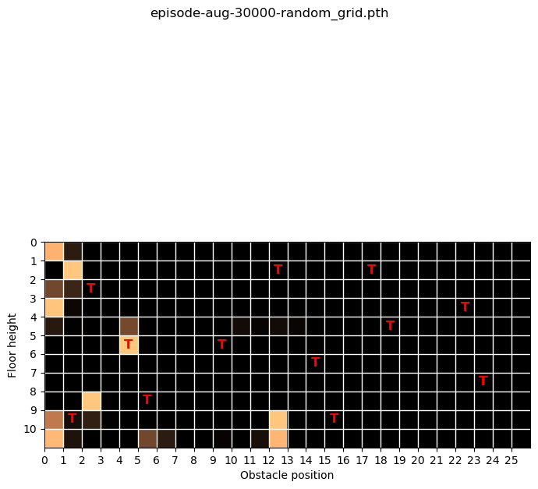

Slide 27
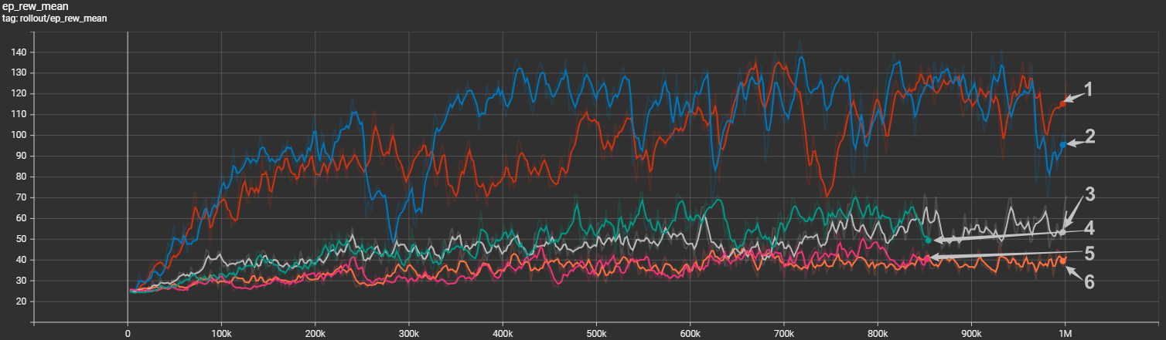
Experiments with SB3 PPO
Trained without augmentation on narrow configuration
Trained without augmentation on wide configuration
Trained with two shift augmentations on narrow grid
Trained with many augmentations on narrow grid
Trained with many augmentations on wide grid
Trained with two shift augmentations on wide grid

Slide 28
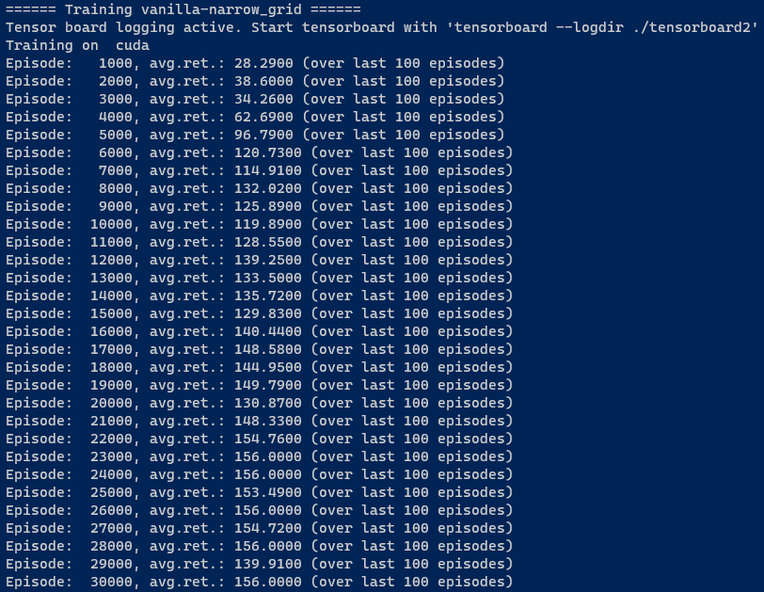
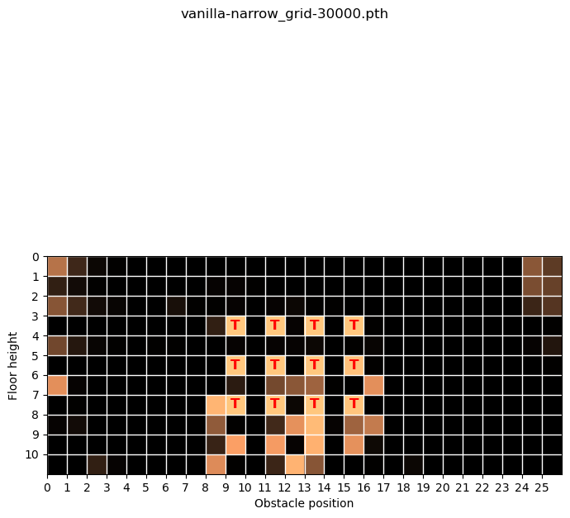
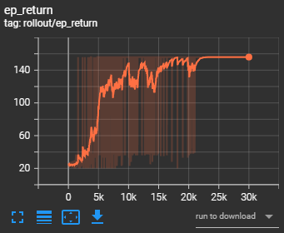

Slide 29
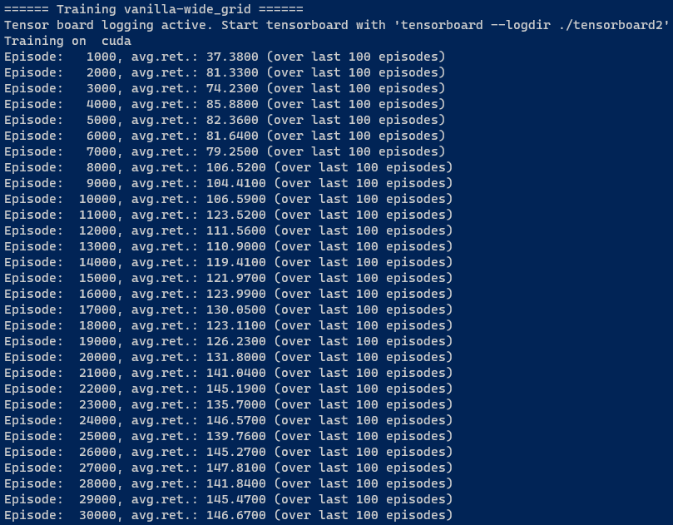
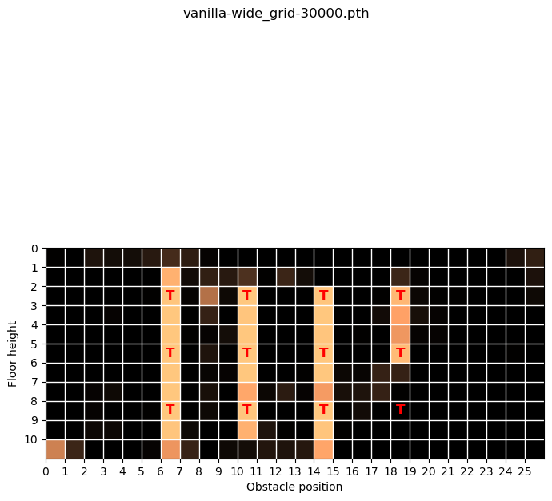
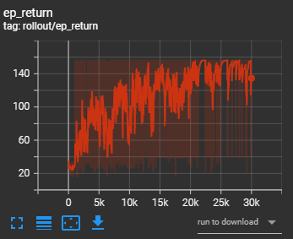

Slide 30
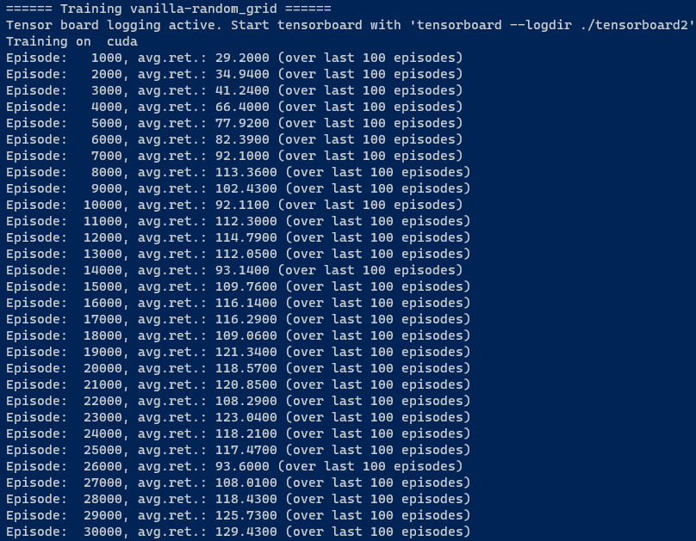
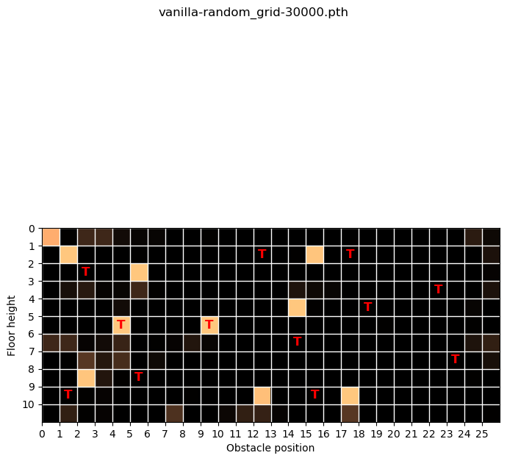
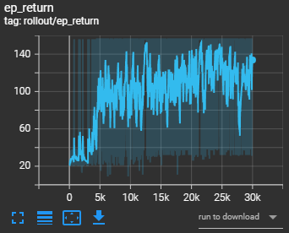
GEFLIPPED!!!

Slide 31
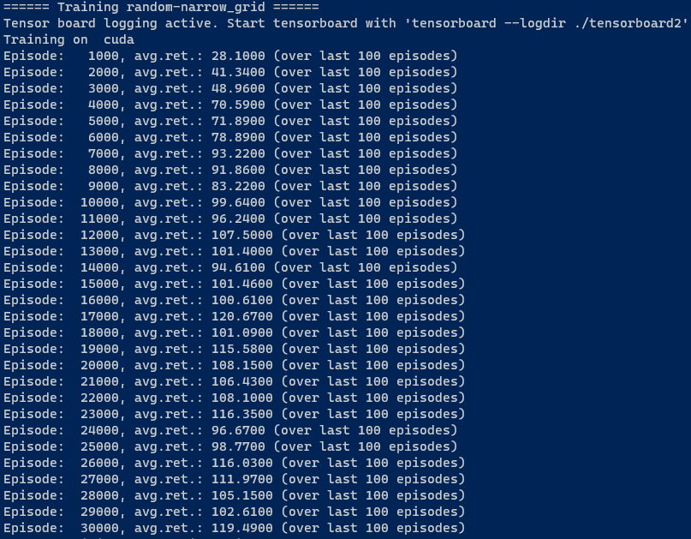
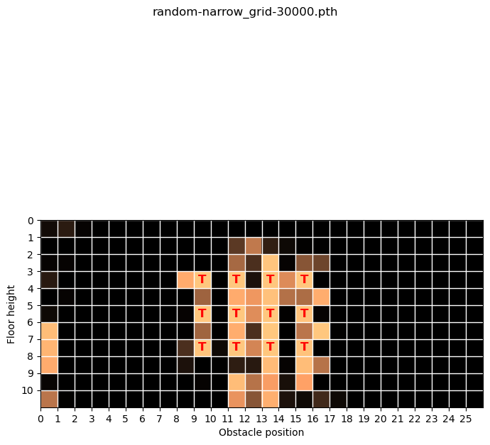
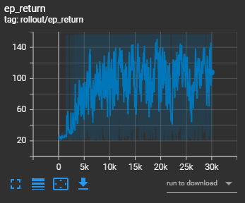
Best performing in terms of generalization!

Slide 32
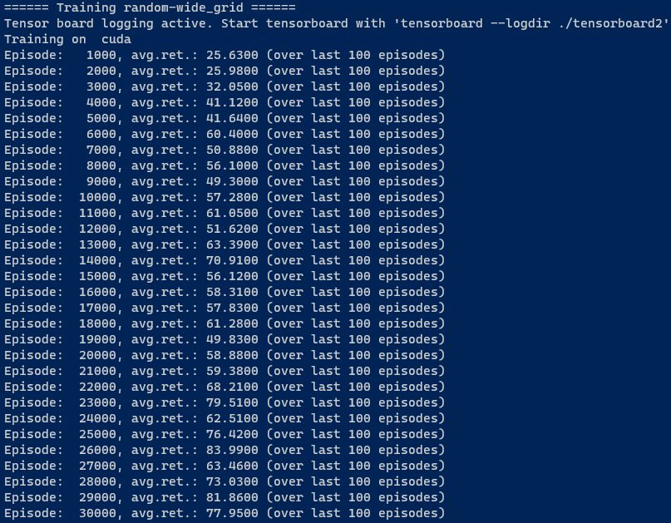
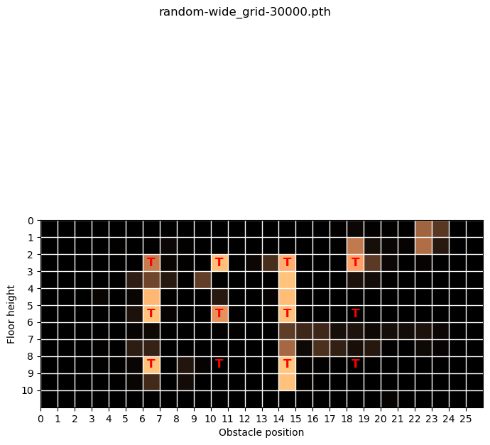
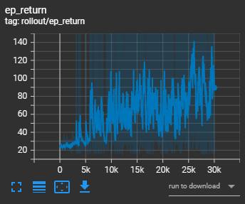

Slide 33
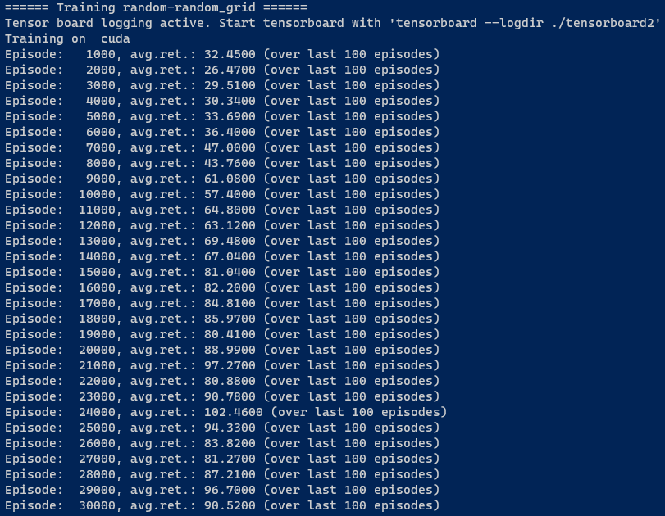



Slide 34




Augmentation “Identity” was chosen nearly every time by UCB.
The exploration coefficient was c=170

Slide 35




Augmentation “cut” was chosen nearly every time by UCB.
The exploration coefficient was c=170

Slide 36




Augmentation “cut” was chosen nearly every time by UCB.
The exploration coefficient was c=170

Slide 37


Slide 38

UCB
C = 2: [15.0, 15.0, 16.0, 19.0, 18.0, 33.0, 15.0, 15.0, 16.0, 9783.0, 32.0, 16.0, 28.0, 29.0] (cutout)
C = 2: [10511.0, 23.0, 21.0, 26.0, 20.0, 34.0, 21.0, 32.0, 26.0, 67.0, 21.0, 20.0, 38.0, 23.0] (identity)
C = 50: [112.0, 75.0, 73.0, 73.0, 88.0, 86.0, 88.0, 107.0, 9863.0, 98.0, 105.0, 108.0] (cutout)
C=100: [47.0, 56.0, 55.0, 47.0, 48.0, 66.0, 49.0, 11600.0, 48.0, 47.0, 84.0, 48.0] (cutout)
C=200: [334.0, 318.0, 310.0, 299.0, 337.0, 372.0, 8763.0, 335.0, 360.0, 335.0, 334.0, 335.0] (random crop)
C=30

Slide 39
Questions
When to choose the augmentation? At every step? Or for every episode and keep the augmentation for the entire episode?
gym.vector.SyncVectorEnv for speed up?
Normalize observations before inserting them into the first layer or is Layer Norm enough? Where to place LayerNorm layer? How to normalize images in RL (no access to entire training data set for mean & std calculation)
Should I plot steps or episodes (average reward over last 100 steps looks obviously way smoother than cumulative reward per episode)
How to rescale images after translation augmentation?

Slide 40

Questions
SB3 learns faster in the beginning. My PPO implementation needs a bit until it climbs. Is this just initialization or is there something additional to consider?
* Its not the x scale. SB3 counts steps, I currently count episodes
* I know I compare episode length, because SB3 calculates reward curve differently

Slide 41
Zusätzliche Augs
Gaussian Filter
Mit und ohne Alliasing

Slide 42



Slide 43



Narrow grid
PPO with random augmentations
PPO without augmentations
DrAC with random augmentations

Slide 44



Wide grid
PPO with random augmentations
PPO without augmentations
DrAC with random augmentations

Slide 45



Random grid
PPO with random augmentations
PPO without augmentations
DrAC with random augmentations

Slide 46


Random sampling vs UCB
UCB Sampling
Random Sampling

